Slide 1
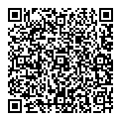
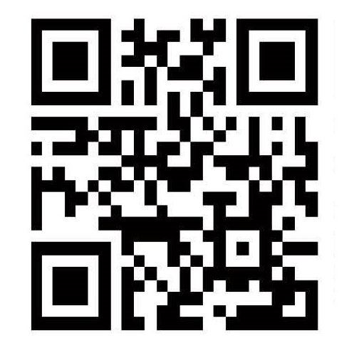
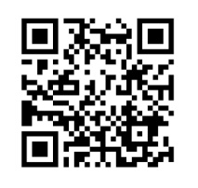
Pre-booking required
FY2026
Parents’ Classes
July 2026
Life during pregnancy, the delivery process, postpartum life, introduction to maternal and
child health services
Bathing (not using hot water), welcoming a baby (work)
Lecture
Practical seminar
Eligibility | Minato citizens who are expectant mothers, and their partners *The expectant mother and/or the partner may also participate alone. The participant may bring along an older child, but childcare services are not provided. *If you plan to bring an older child along, please call and inform Minato Public Health Center.
Capacity | 40 couples each session（first-come-first-served basis）
Time
Venue | 4F, Imperial Gift Foundation Boshi-Aiiku-Kai（5-6-8 Minami-azabu, Minato City）Not held at Aiiku Clinic. *Please see the “Parents’ classes website” for a details map. Note that you cannot enter via the premises of Aiiku Clinic.
What to bring | Maternal and Child Health Handbook, writing materials, bag to hold A4 size materials, bath towel
Booking | Online booking: In the Minato Maternal and Child Health Handbook App, Minato Public Health Center medical checkups, etc. booking system *Please note that only fixed appointment dates are available.
13:15 ～ 15:15（Registration from 12：45)
Parents’ classes website
The dates on which you can participate vary depending on your due date. Please check before applying.
We recommend attending the class by 35 weeks and 6 days of pregnancy.
All classes are hold on Saturdays.
Each couple can only participate in the class once.
Minato Maternal and Child Health Handbook app
Schedule
Class date | Eligibility (Due date) | Online booking period
2026 April 4 April 18 | 2026 April - July | March 1 - 20
May 9 May 23 | May - August | April 1 - 20
June 6 June 20 | June - September | May 1 - 20
July 4 July 18 | July - October | June 1 - 20
August 8 August 22 | August - November | July 1 - 20
September 5 September 19 | September - December | August 1 - 20
Class date | Eligibility (Due date) | Online booking period
2026 October 3 October 17 | October 2026– January 2027 | September 1 – 20
November 7 November 21 | November 2026 – February 2027 | October 1 - 20
December 5 December 19 | December 2026– March 2027 | November 1 - 20
2027 January 9 January 23 | 2027 January – April | December 1 - 20
February 6 February 20 | February - May | 2027 January 1 – 20
March 6 March 20 | March - June | 2027 February 1 – 20
Regarding participation
Points to note:
Videos showing the steps of bathing a baby are available online. [QR code below] Please watch it before coming to class.
Please check your physical condition before coming to class. If you do not feel well, please reschedule and participate another day.
If you wish to cancel your booking, please be sure to contact Minato Public Health Center at least one day before the class.
On the day itself, please contact the Training Department of the Boshi-Aiiku-Kai.
Classes may be cancelled in the event of stormy weather or disasters.
Please refrain from coming by car.
37.5℃
Inquiries
Public Healthcare Subsection, Health Promotion Section, Minato Public Health Center
Contact on the day:
Boshi-Aiiku-kai Training Dept.
03-3473-8335
03-6400-0084
FAX
03-3455-4539
Minato City implements projects in compliance with laws related to the protection of personal information, so you can participate in our projects with peace of mind.

